Slide 1



Fabrication of Patterned Gate Devices for
High-Resolution Tunneling Spectroscopy
Giovanna Campisi
California State University, Northridge
Ali Yazdani
Joseph Henry Laboratories, Department of Physics, Princeton University
July 12, 2024

Slide 2
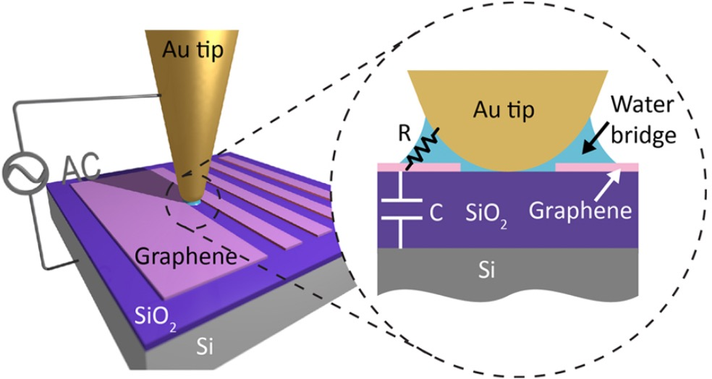
This talk focuses on the fabrication methods of devices designed to host novel quantum states
Monolayer Graphene
hBN
Patterned Gate
hBN
Graphite Bottom Gate
Si/SiO₂ Chip
Li et al. Nano Letters 18, 2018
Device Fabrication
Patterned Gate Fabrication
Outlook
Notes:
The Yazdani lab here at Princeton engineer heterodevices on the microscale that can host novel quantum states. The way they engineer these heterodevices is to stack layers of these materials together
Similar to building a capacitor or a transistor, and use applied voltages and magnetic fields at low temperature to force the carriers in the active layer of the heterodevice into strange or new quantum states
One of the ways this is done is through using a patterned gate.
In this talk I will walk you all through the device design and how a patterned gate is made and its purpose, as well as quickly show how these microscopic devices are built.

Slide 3
Layered or stacked hetero structures allow for microscale engineering to produce desired quantum material characteristics
Insulating layers:
hexagonal Boron Nitride
Graphene Active Layer:
where the novel quantum states will be measured
Monolayer Graphene
hBN
Patterned Gate
hBN
Bottom Gate
Si/SiO₂ Chip
Graphite Patterned Gate:
controls carrier energy in active layer
Graphite Gate Electrode:
controls current density in active layer
Notes:
The device I designed is simple, consisting of a bottom electrode, the patterned gate shown in green, the active layer (MLG) and insulating layers of hex boron nitride. The bottom gate is made of graphite and connected to a bias voltage; the patterned gate is connected to a different voltage source, and the mlg later is grounded, completing the circuit.

Slide 4
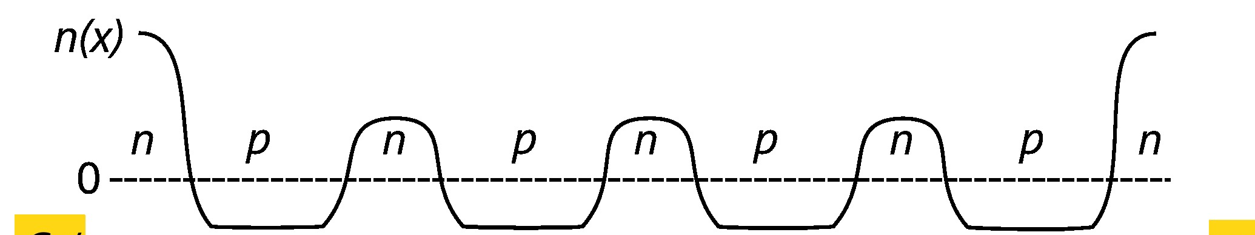
Cartoon Cross Section of Potential Traps
Graphene
hBN Insulating Layer
Graphite Patterned Gate
hBN Insulating Layer
Graphite Gate Electrode
Notes:
A cross section of this device will illustrate this a little better; The top plot shows the carrier density in the monolayer graphene as a function of position. The amplitude of this plot is controlled by the voltage applied to the bottom graphite gate. The location of the peaks and valleys, the texture in that carrier density plot is controlled by the voltage applied to the patterned gate. This creates essentially a potential landscape in the top graphene layer so that carriers can be locally trapped.

Slide 5
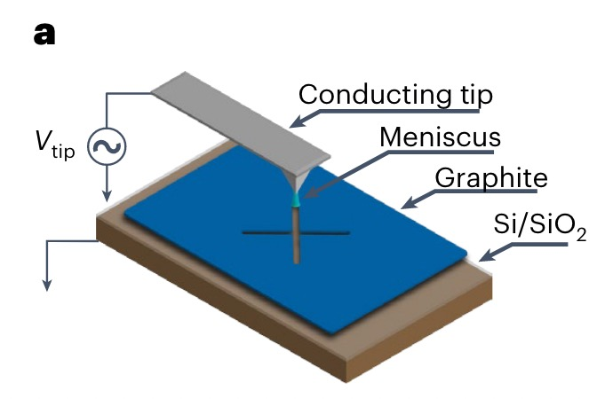
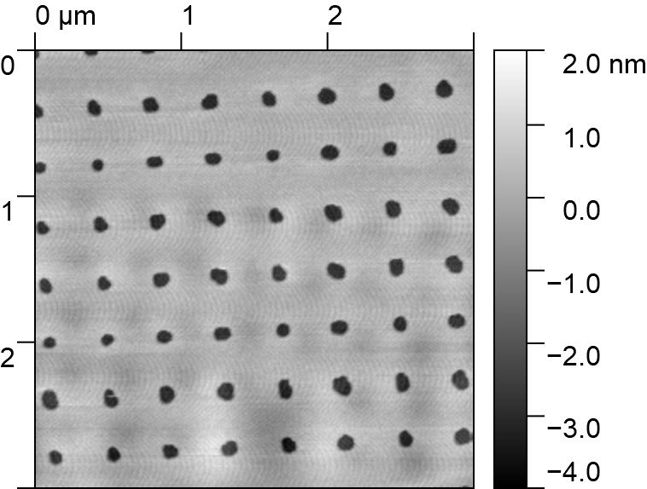
Patterned gates are etched conductive flakes of a material meant to locally change the potential felt by carriers in the active device layer.
Cathode
Anode
Cohen et al. Nature Physics 19, 2023
Notes:
To create this patterned gate however, patterning needs to be done on a microscale graphite flake. There are many ways currently being used by different research groups, such as photo lithography, e-beam lithography, laser etching etc etc. What we use in the Yazdani lab is called Electrode Free Local Anodic Oxidation. This is a method done in-situ on the AFM in where a driving AC voltage is forced between a conductive AFM tip and the chip beneath by use of a water bridge. This allows for oxidation of the flake between the cathode and anode; resolution is on the scale of the AFM itself, while the quality of the etching is controlled by the water bridge size, the thickness of the chip and the control voltage.
My Patterned Gate design utilizes nano-pores; holes in the PG 60nm in diameter that can trap carriers.

Slide 6
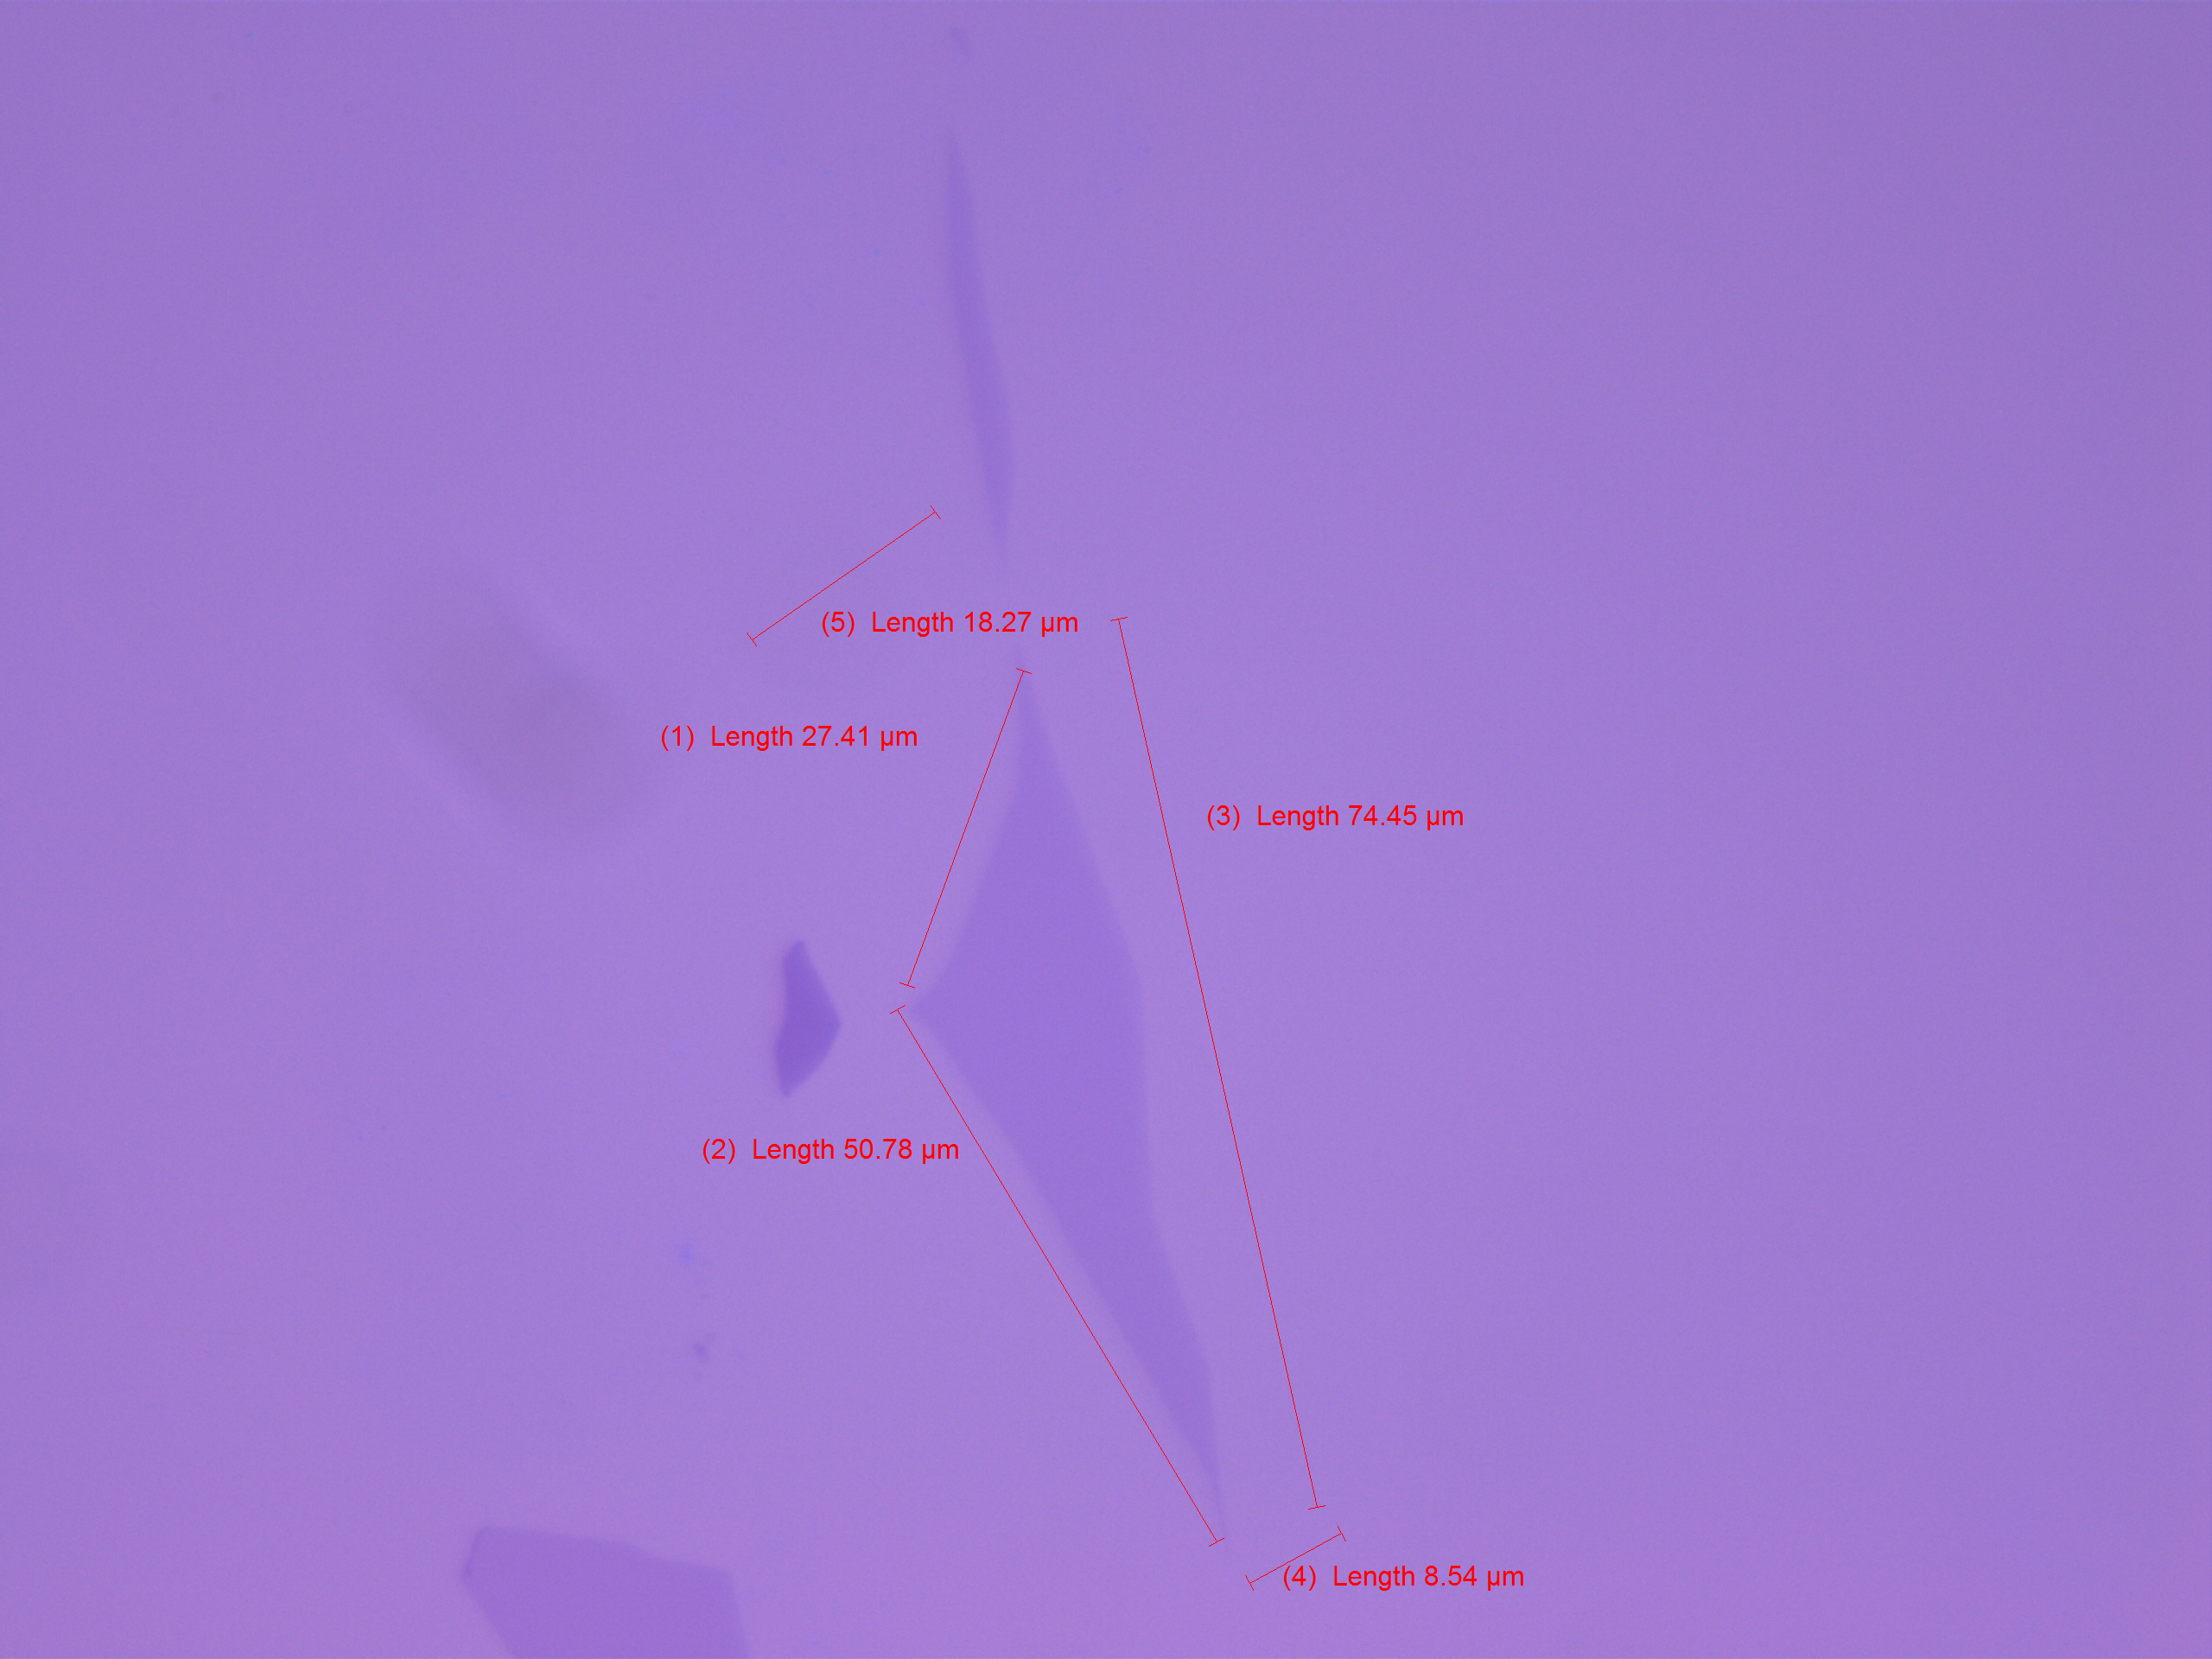
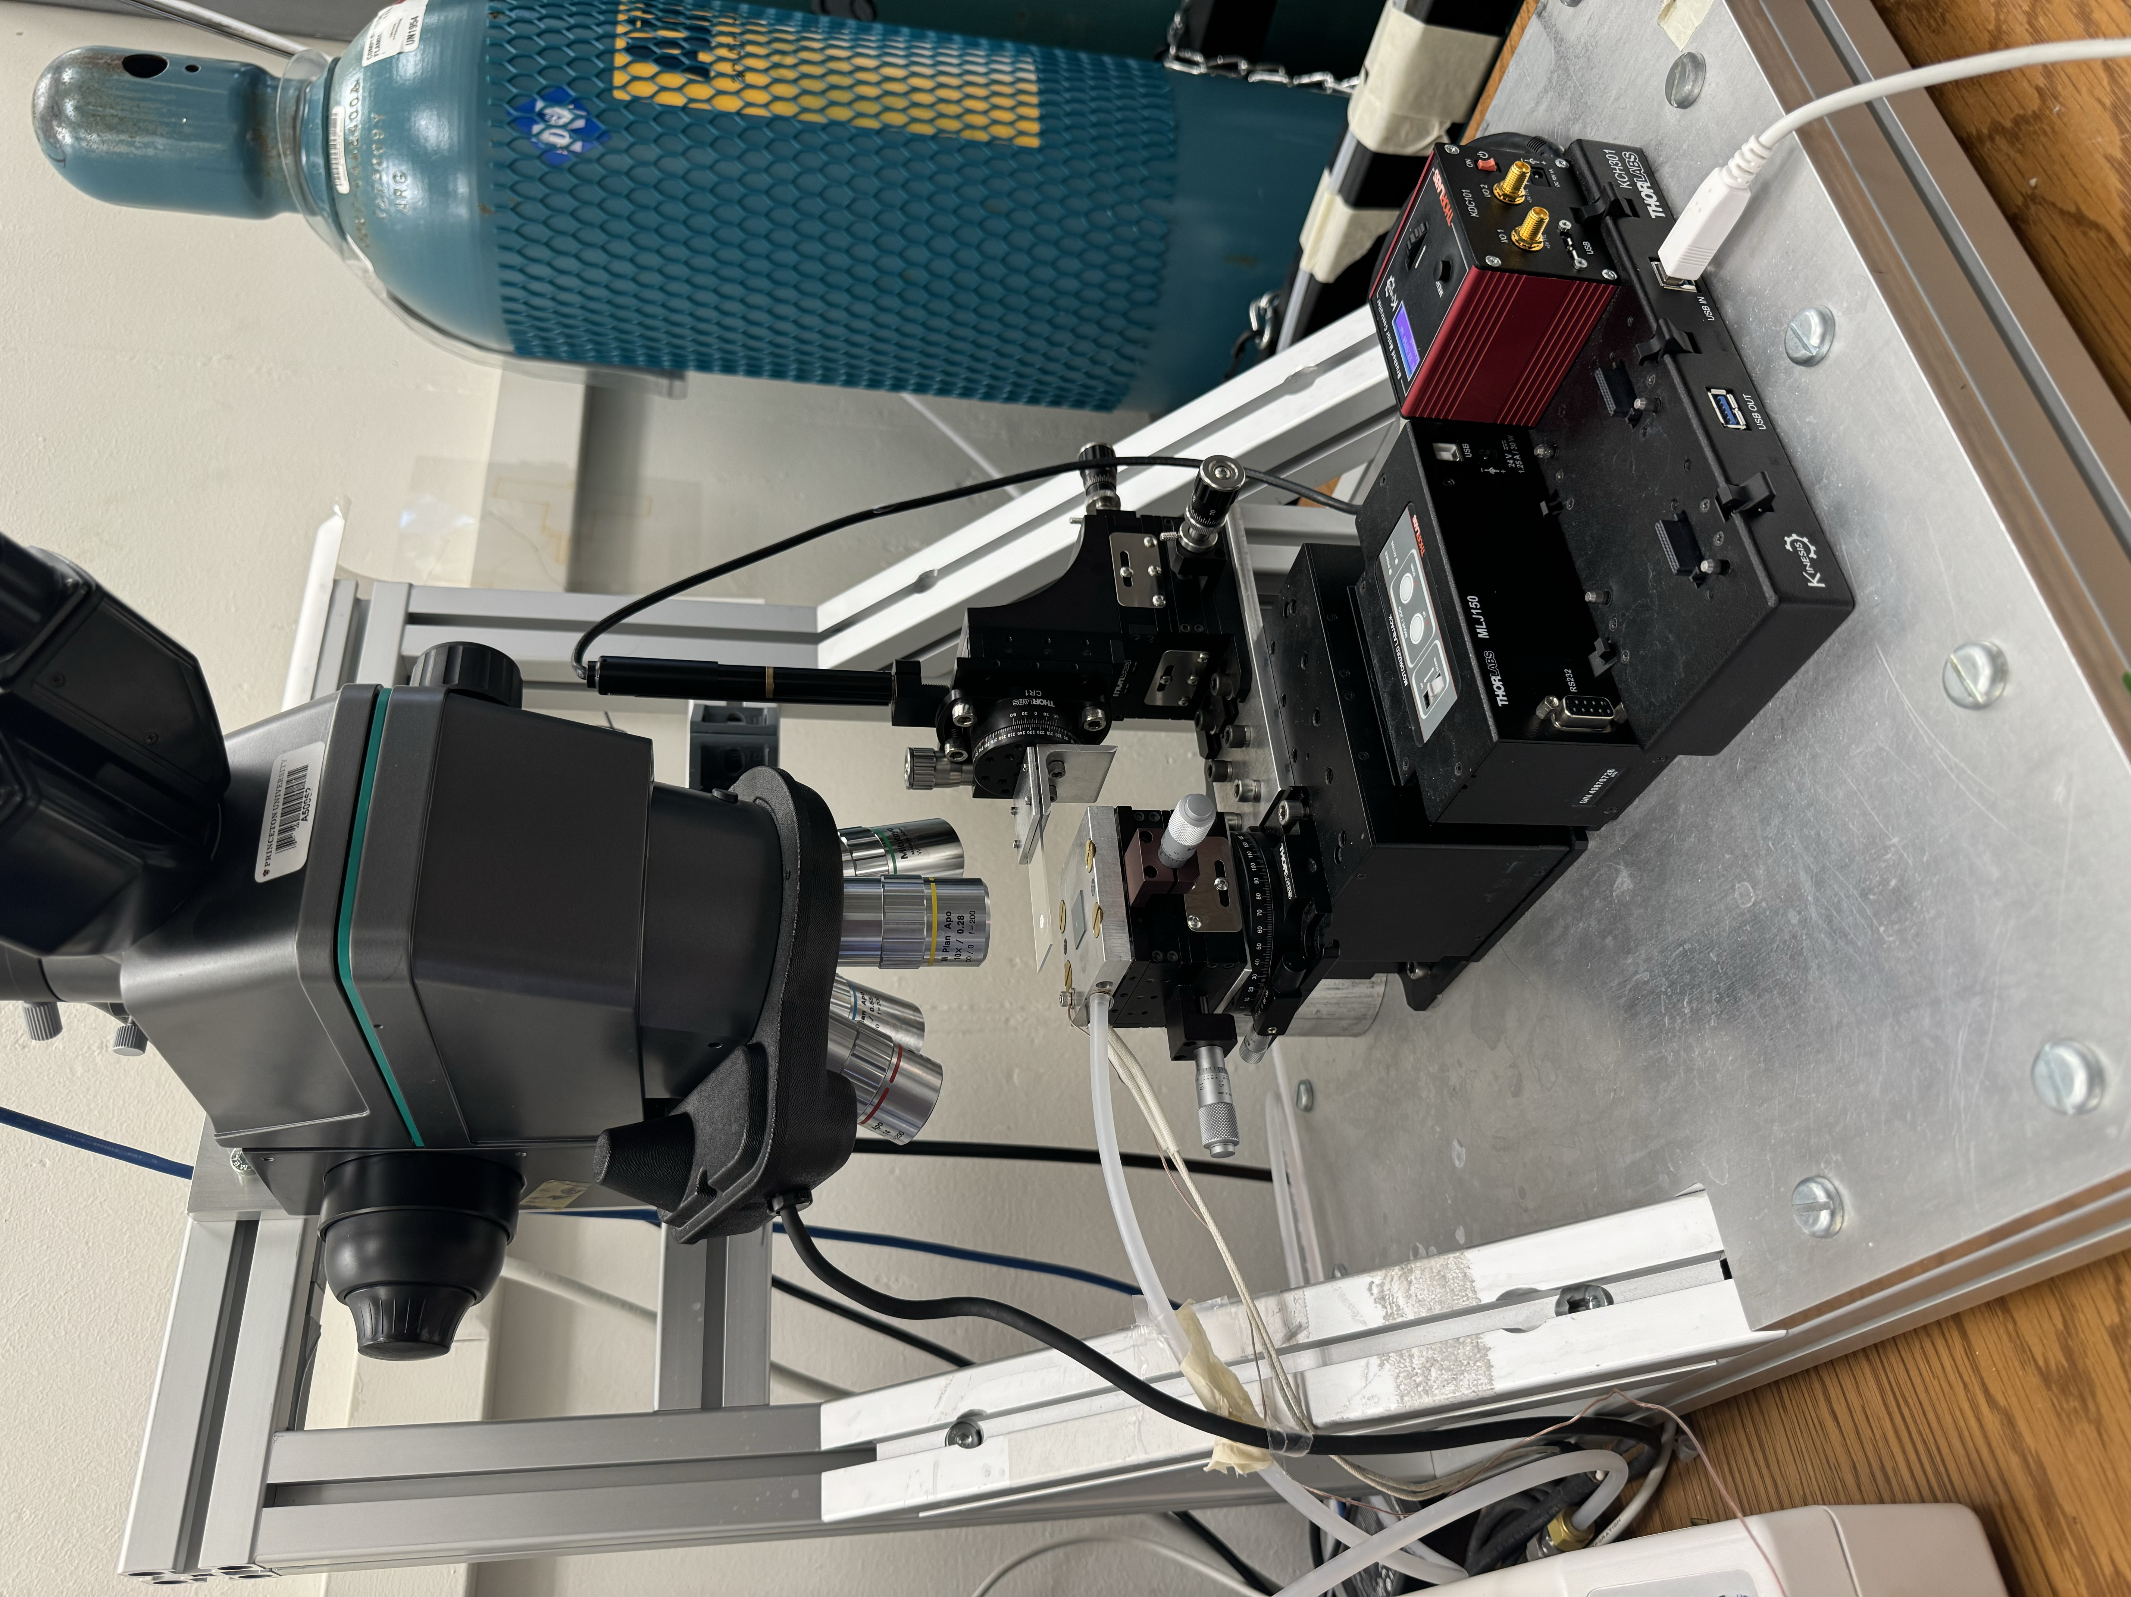
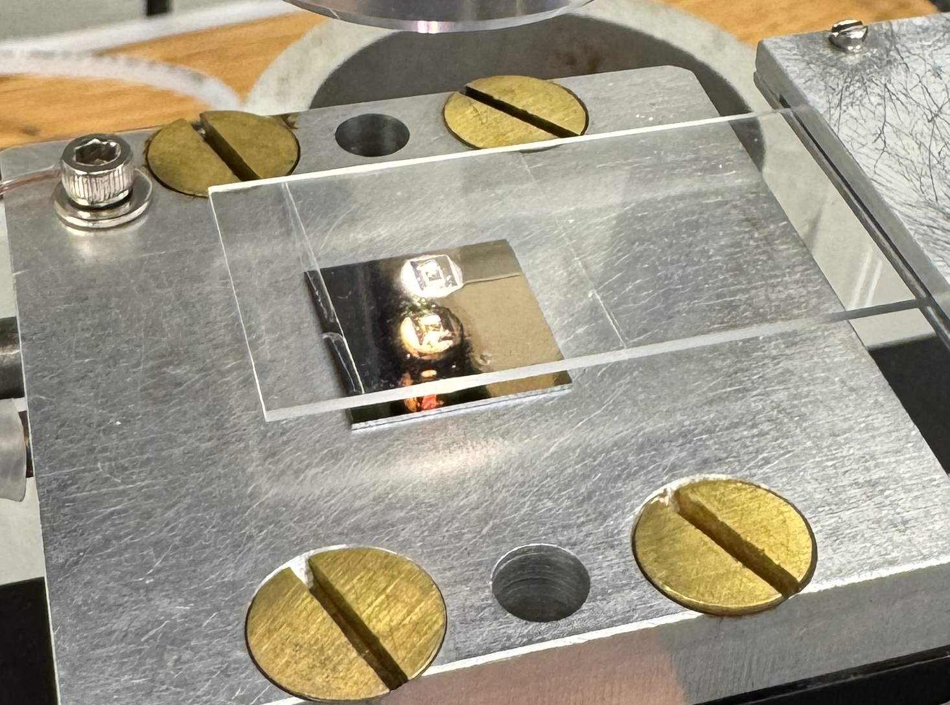
Device Construction: Stacking mechanically exfoliated flakes
Notes:
Once the patterned gate has been constructed, the device is stacked using a transfer stage, shown here.

Slide 7
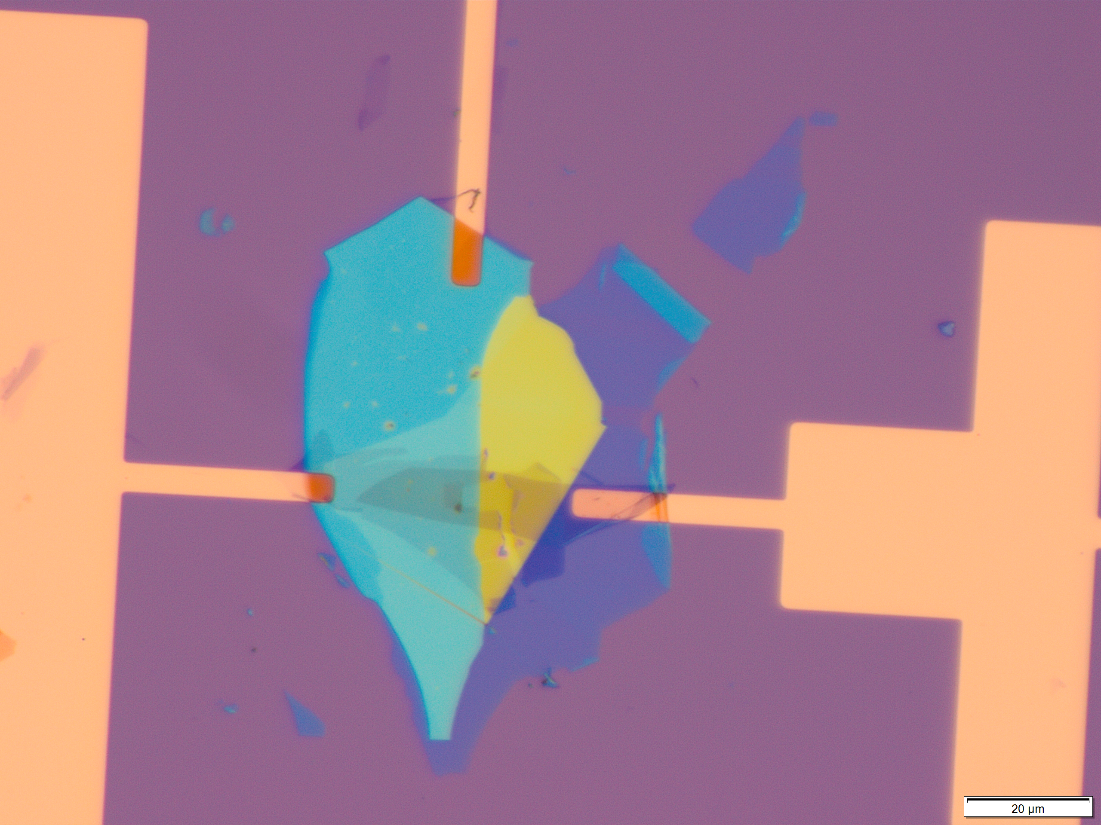

Once the device is inserted into the STM, tunneling spectroscopy data can be taken (at low T and high $\vec{B}$) and quantum states for strongly correlated quasiparticles can be trapped in the features etched into the Patterned Gate.
Notes:
A completed device is shown on the left, you can see that specific flakes are attached to gold electrodes to be controlled in the STM. In the stm, a high magnetic field is applied and temperature is lowered to the millikelvin range for imaging.
Shown on the right is an image from the last device used in the lab. It is a dI/dV plot and shows the landau levels of the carriers trapped in a certain pattern gate feature. Ideally, when my device gets measured, we will be able to see tightly correlated electrons forming a quasiparticle that exhibits the fractional quantum hall effect or an anyon that obeys non-abelian statistics

Slide 8
Thank you for your Attention
Questions?
Notes:
Black slide left for drafting conclusion

